Slide 1







ACCOUNTING RECREATIONAL CLUB
F
R
E
S
H

Slide 2


PART 01
2020 ARC Committee

Slide 3

President | Clement Yong Hwa Seng
Vice President | Austin Hii Dai Leon
Secretary | Ester Lu Kah Ong
Treasurer | Chiu Zhi Kong
Auditor | Alex Moh Shi Kiong
Event Coordinator | Chee Soon Teck, Ting Yiann Yii, Emily Law Shi Ching, Irene Tiong Lui Ping, Kavin Ling Chee Hoe
Public Relation | Albert Kong King Hong, Koh Zhi Kan, Wilson Ting Chung Kik
Photographer | Priscilla Ting Siew Jing
Advisor | Ms Irene Choo, Mr Timothy Ting, Ms Angela Tiong

Slide 4
PART 02
Mission and Vision

Slide 5


Foster keen interest in studies
A platform for interactions between students and lecturers
A platform for practical of management skill
Provide outside classroom learning

Slide 6
PART 03
Membership

Slide 7


The membership fee is payable once for the lifetime as MPI student
All members shall be entitled to all rights and privileges of this club, such as:
Voting in Annual General Meeting (AGM)
Become committee member

Slide 8
PART 04
Event

Slide 9


At least one event in every single semester
EAB point will be provided
Membership fee: RM5 (once for lifetime)
Registration fee: RM10 (every event)

Slide 10
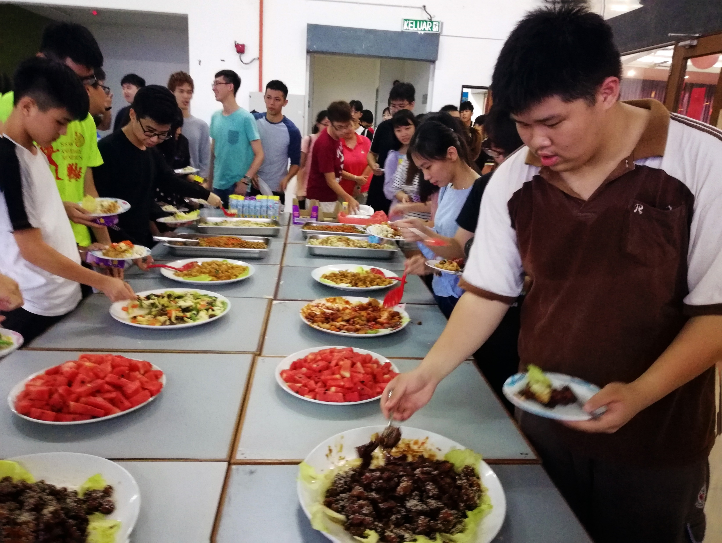
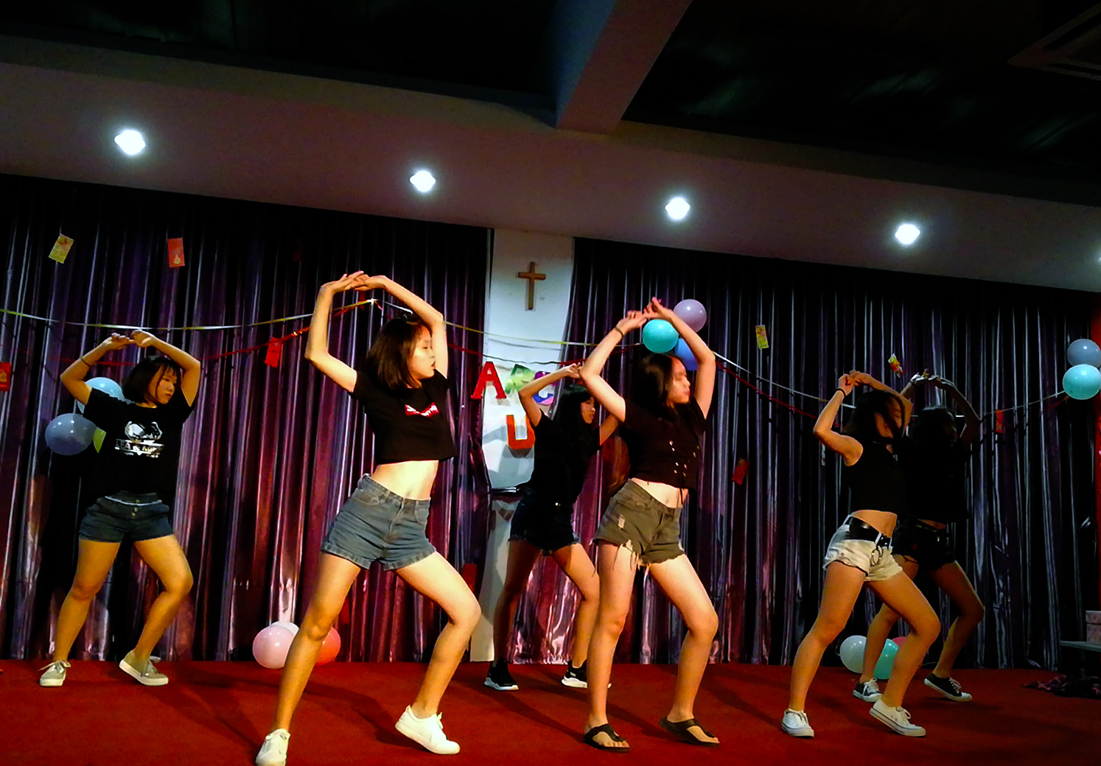
Chinese New Year Event 2019

Slide 11
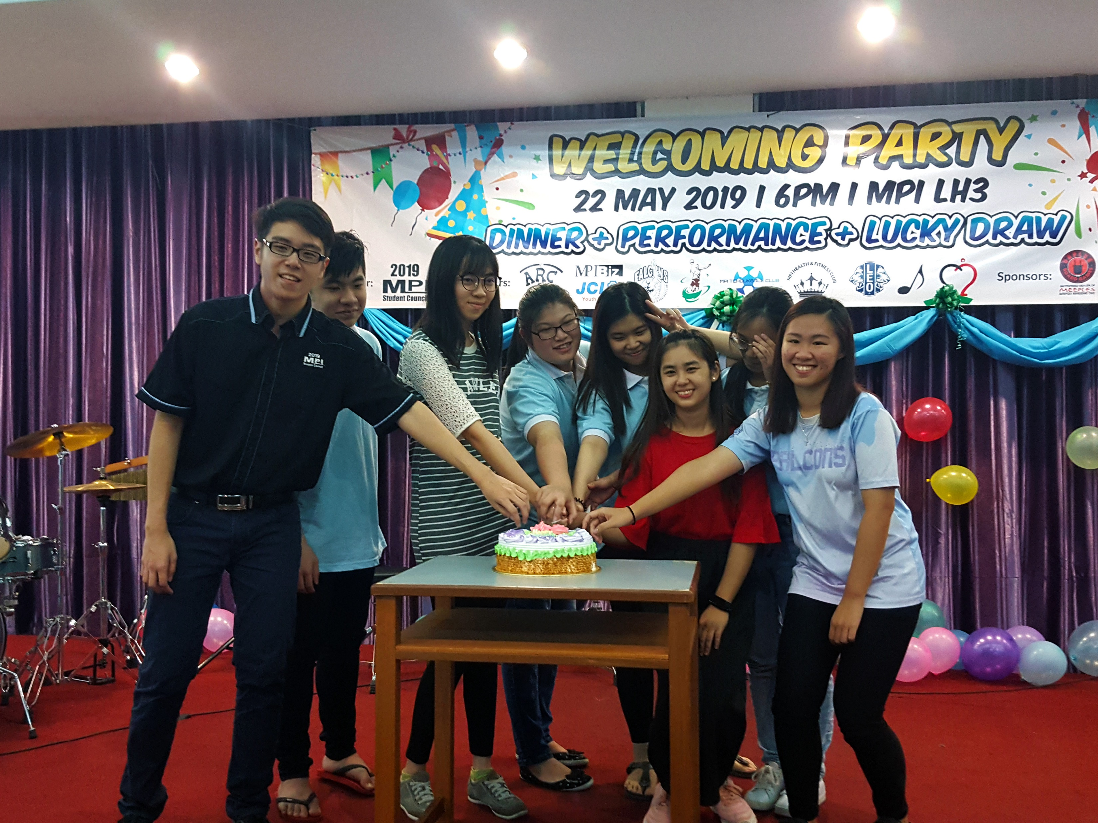
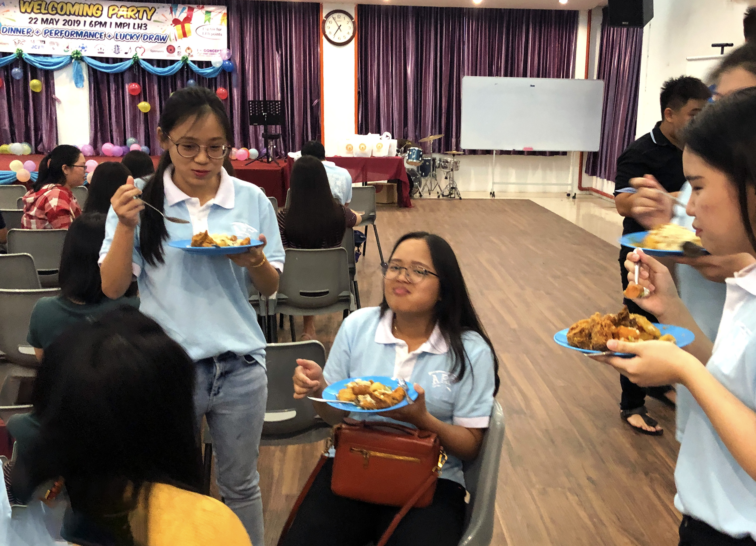
Welcoming Party 2019

Slide 12
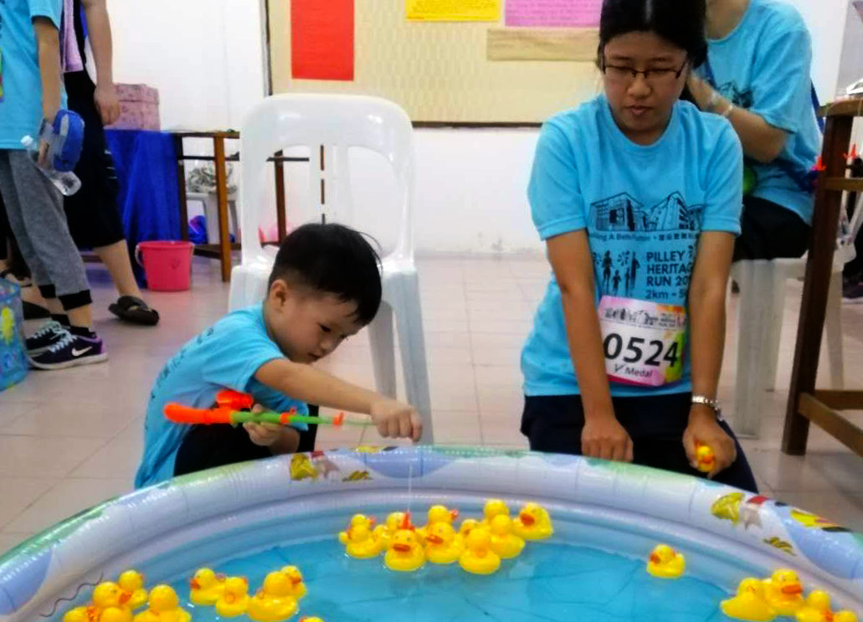
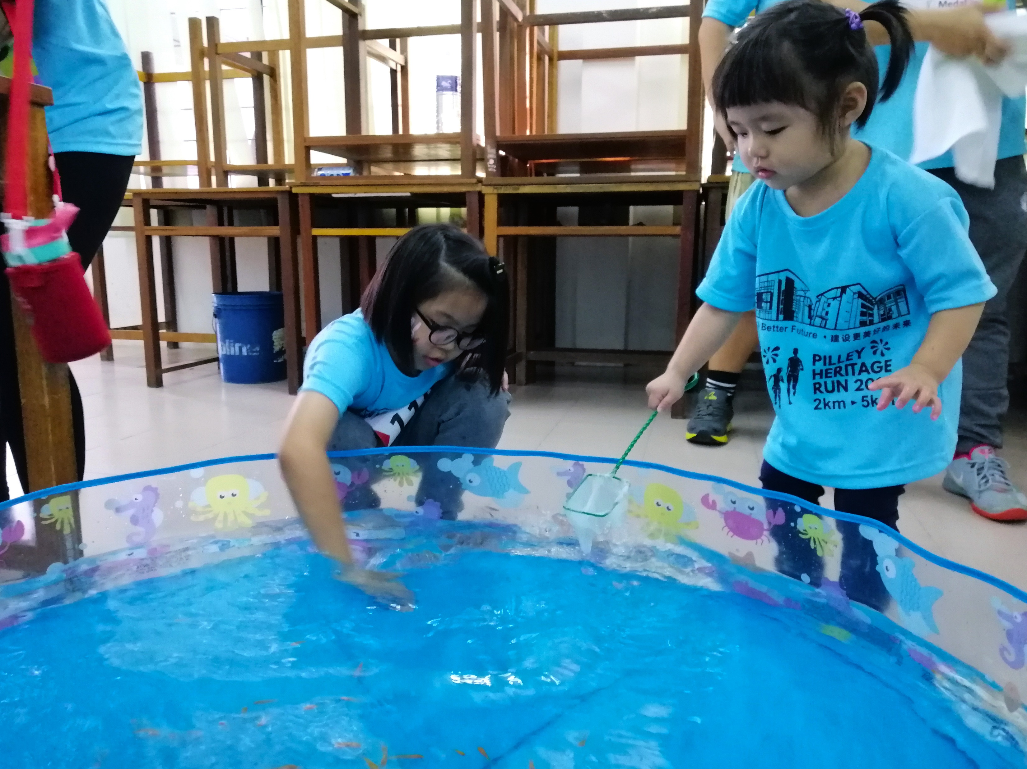
Marathon Festival 2019

Slide 13
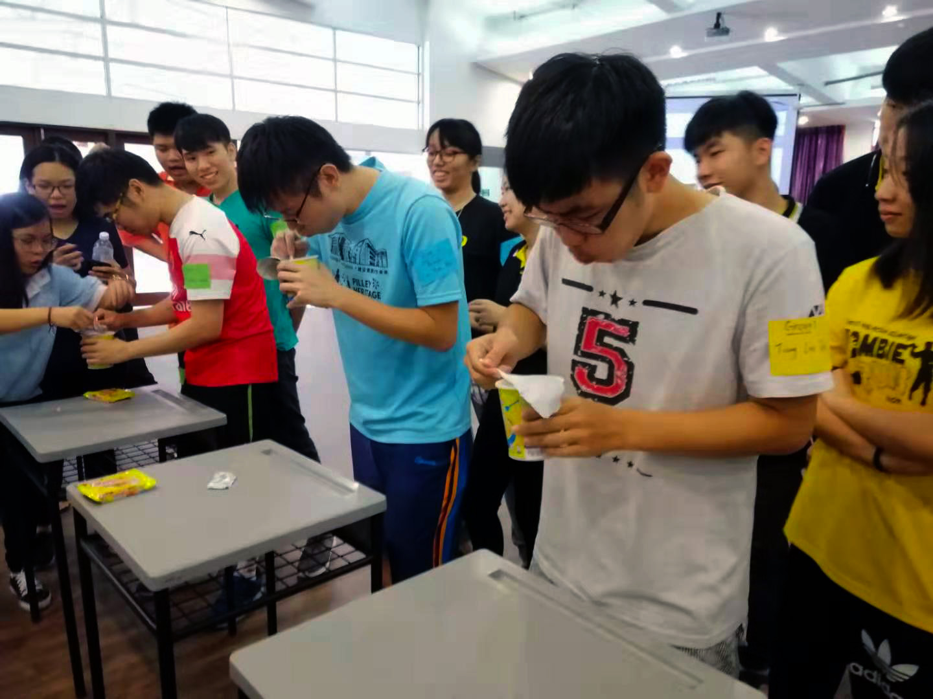
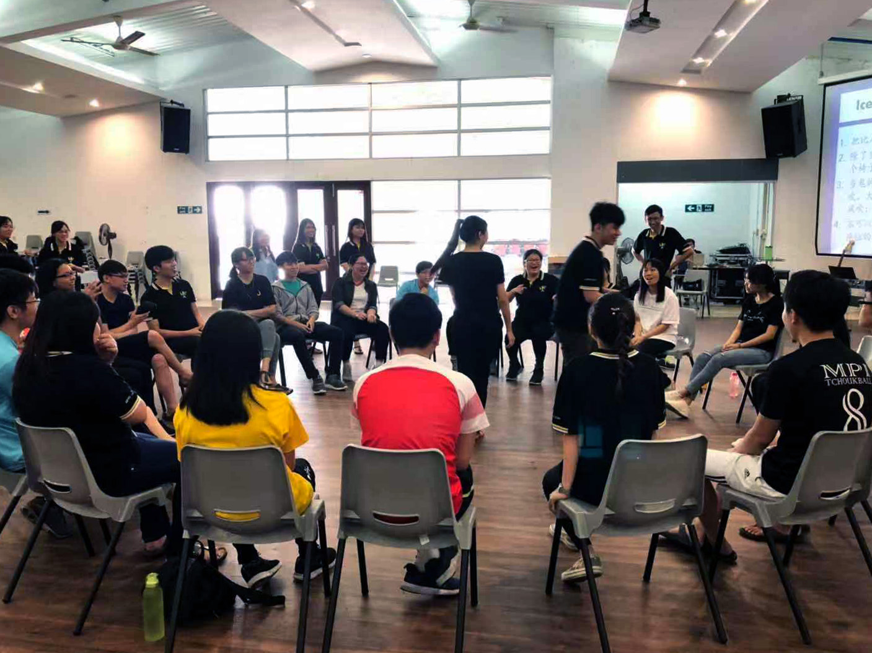
Mooncake Running Festival 3.0

Slide 14
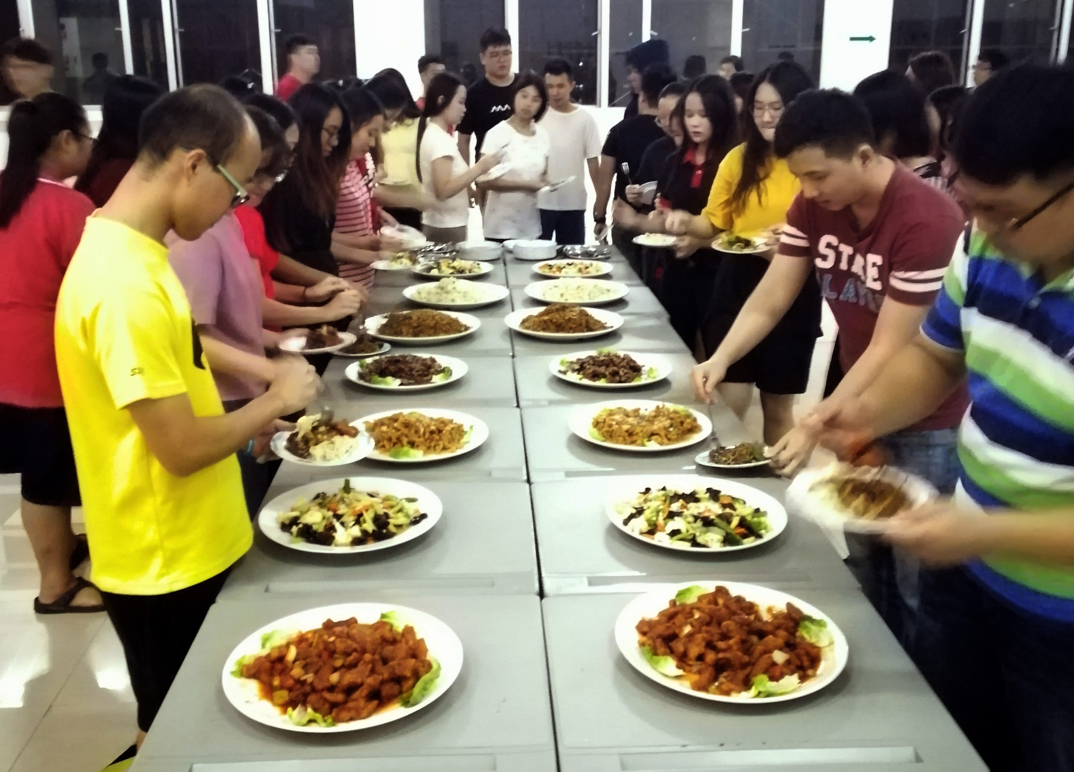
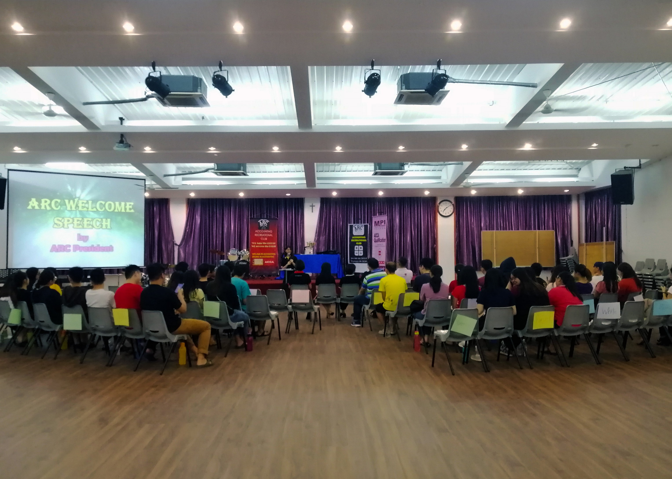
AGM Night 2019

Slide 15

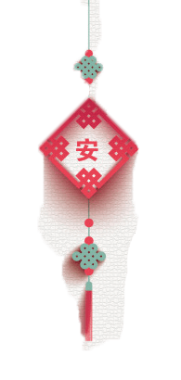


LUNAR NEW YEAR PARTY 2020
DATE : 20th January 2020
TIME : 1830 - 2100
VENUE : Lecturer Hall 3

Slide 16

CONTENTS
目录
壹
DINNER TIME
壹
晚餐时间
壹
INTRODUCTION TO CLUB
贰
社团介绍
壹
ICE BRAKING & GAMES
叁
破冰与游戏
壹
MYSTERIOUS ACTIVITY
肆
神秘活动

Slide 17
PART 05
Social Media

Slide 18



@MPI Accounting Recreational Club
@MPI ARC
arclub20@gmail.com

Slide 19
Thank You
F
R
E
S
H

